Slide 1

Predicting Coupon Acceptance On E-commerce Platforms

Slide 2

Predicting Coupon Acceptance On E-commerce Platforms
Objective: The goal of this project is to predict whether a customer will accept a coupon based on factors like demographics, time, and behavior.
Problem Statement: Businesses use coupons to attract customers, but not everyone redeems them. Understanding which customers are likely to accept a coupon can help businesses target the right audience, improving marketing efficiency.
Outcome: We explored the dataset, cleaned and prepared the data, and tested different machine learning models. After evaluation, we identified the best model for predicting coupon acceptance. This can help businesses make better marketing decisions and increase customer engagement.

Slide 3


Data Overview
1
Dataset Size
12,684 rows and 25 columns of coupon acceptance data.
2
Key Features
Weather , Temperature, Coupon, Expiration, Distance, Occupation
3
Target Variable
Accept(Y/N?)

Slide 4
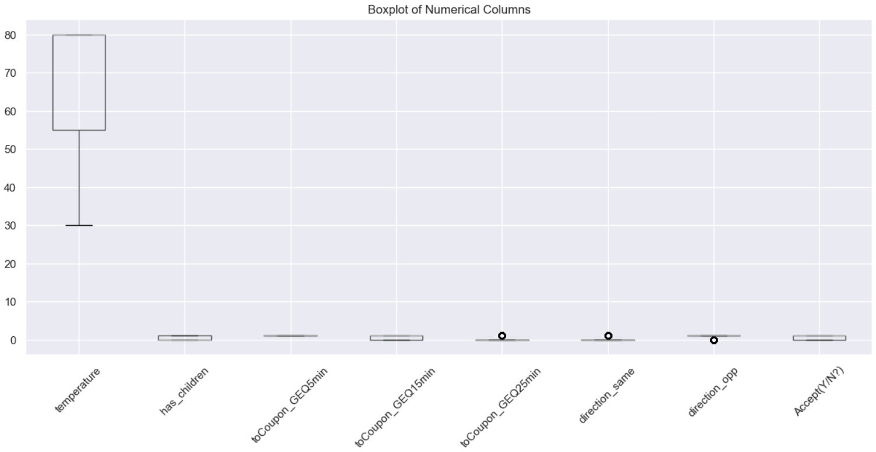

Data Preprocessing
1
Handling Missing Values
Used median imputation for numerical variables and most frequent value(mode) for categorical.
2
Outlier Treatment
Applied IQR based capping to reduce impact of extreme values.
3
Feature Scaling
Standardized numerical features using StandardScaler to ensure consistent scale across variables.

Slide 5
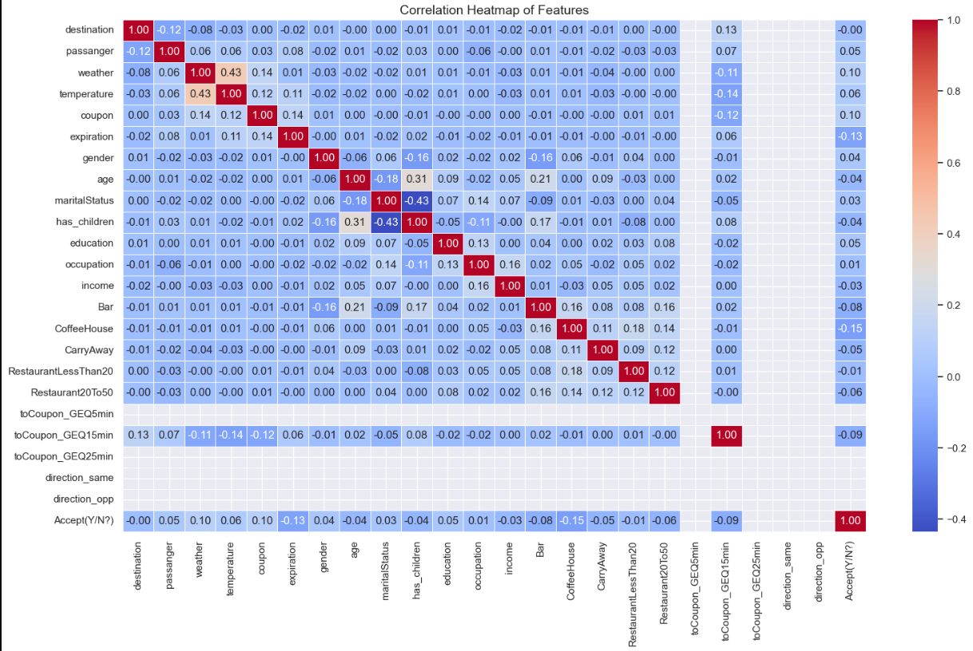
Exploratory Data Analysis
Co-relation Analysis
Co-relation Heatmap revealed relationships between variables, guiding feature selection.

Slide 6
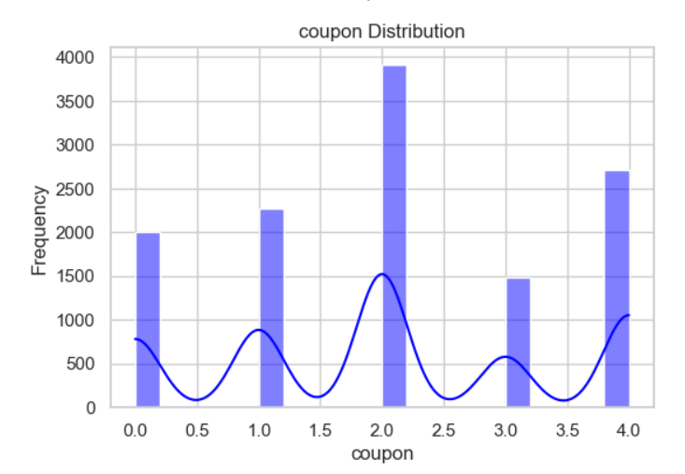
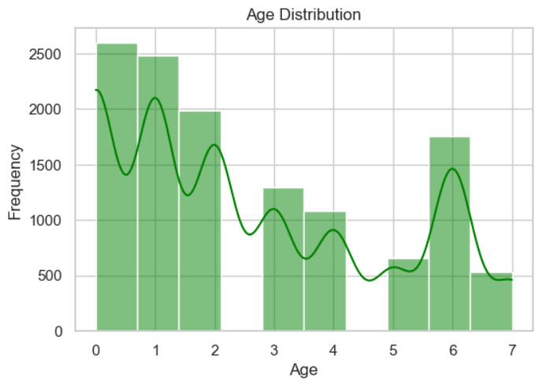
Exploratory Data Analysis
Distribution Plots
Showed data distributions, helping identify potential issues.

Slide 7
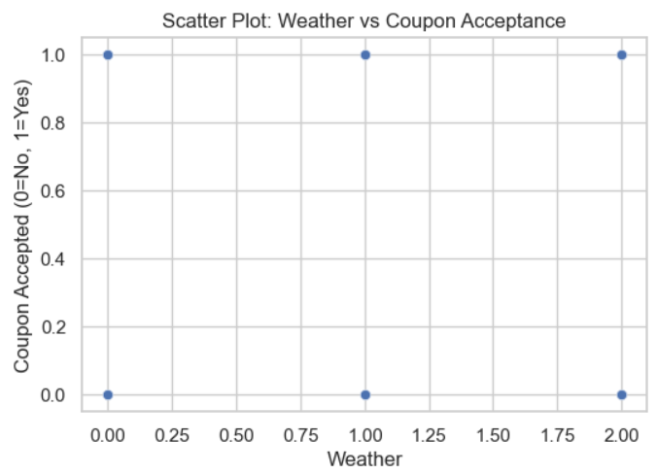
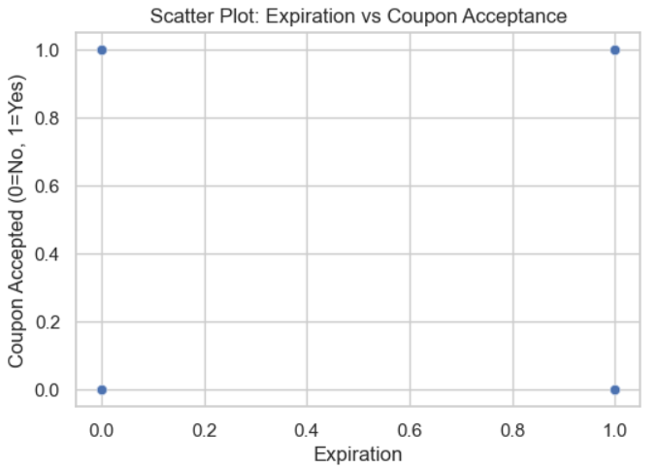
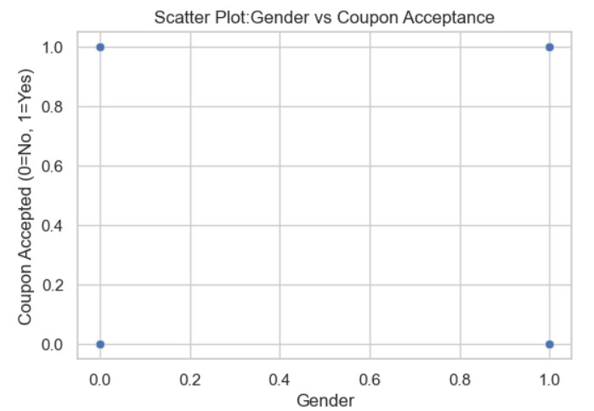
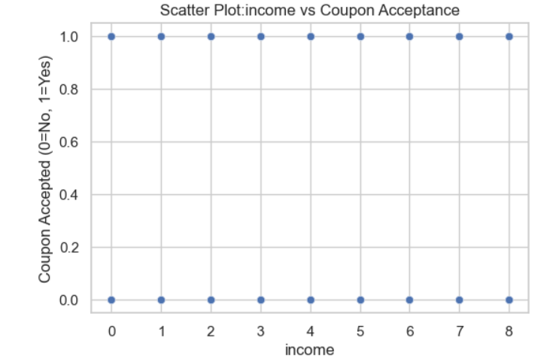
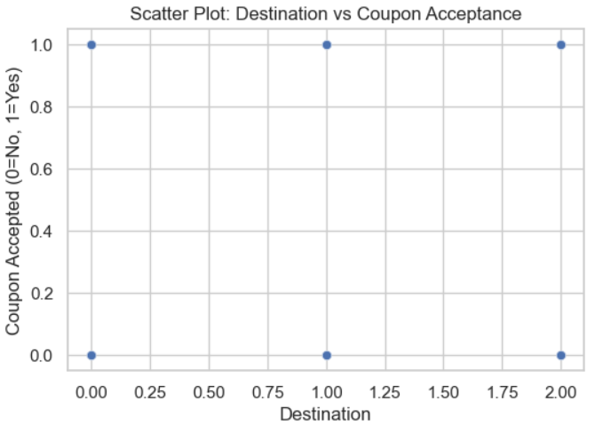
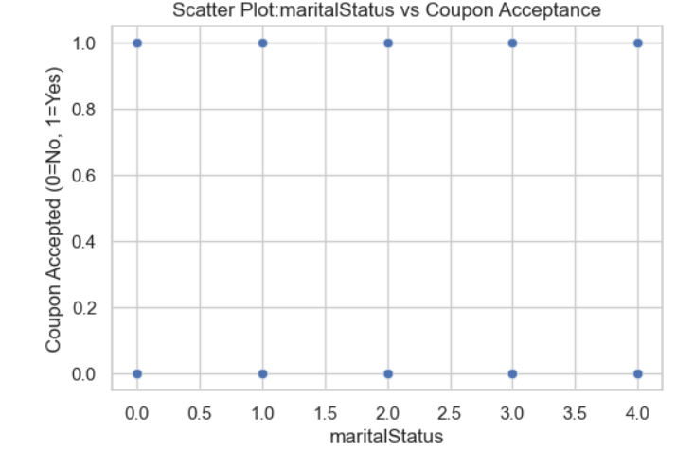
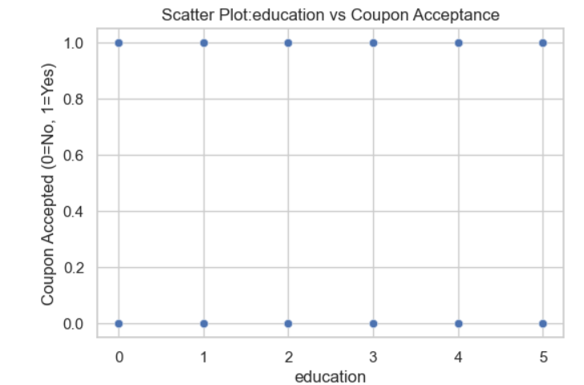
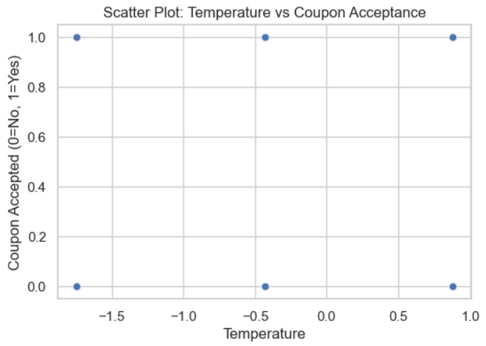
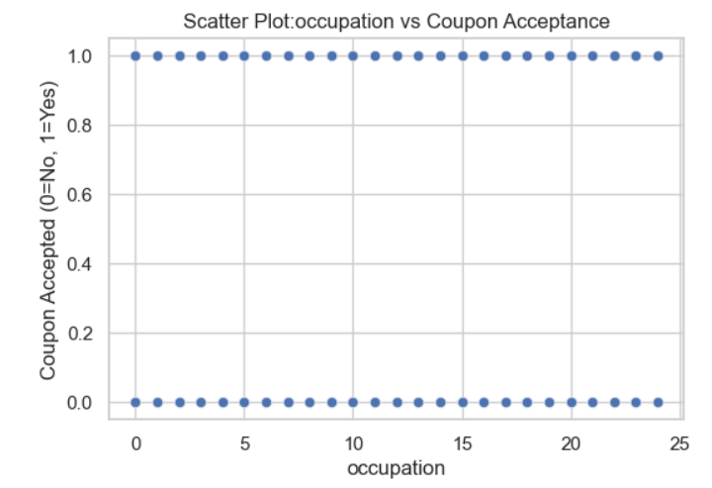
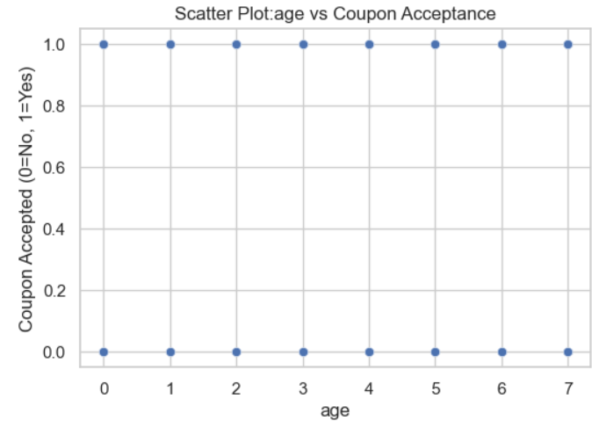
Exploratory Data Analysis
Scatter Plots
Pairwise scatter plots highlighted relationships between features and target variable.

Slide 8
Model Selection
Classification Models
Splitting Data
Optimization
Logistic Regression, Random Forest, XG Boost, Logistic Regression, Ridge Classification, Gradient Boosting Classification, AdaBoost Classification, SVC, Linear SVC, K neighbors Classification, Gaussian Naive Bayes, Bernoulli Naive Bayes, Decision Tree , Perceptron
Use train-test splitting and cross-validation.
XG Boost for potentially higher accuracy for better accuracy.

Slide 9
Model Training and Evaluation
Data Splitting
Performance Metrics
80% training, 20% testing split for model evaluation.
Evaluated models using Compare models using accuracy, precision, recall, F1-score, and AUC-ROC.
1
2
3
Cross Validation
Performing Cross Validation on all models and comparing their accuracies

Slide 10
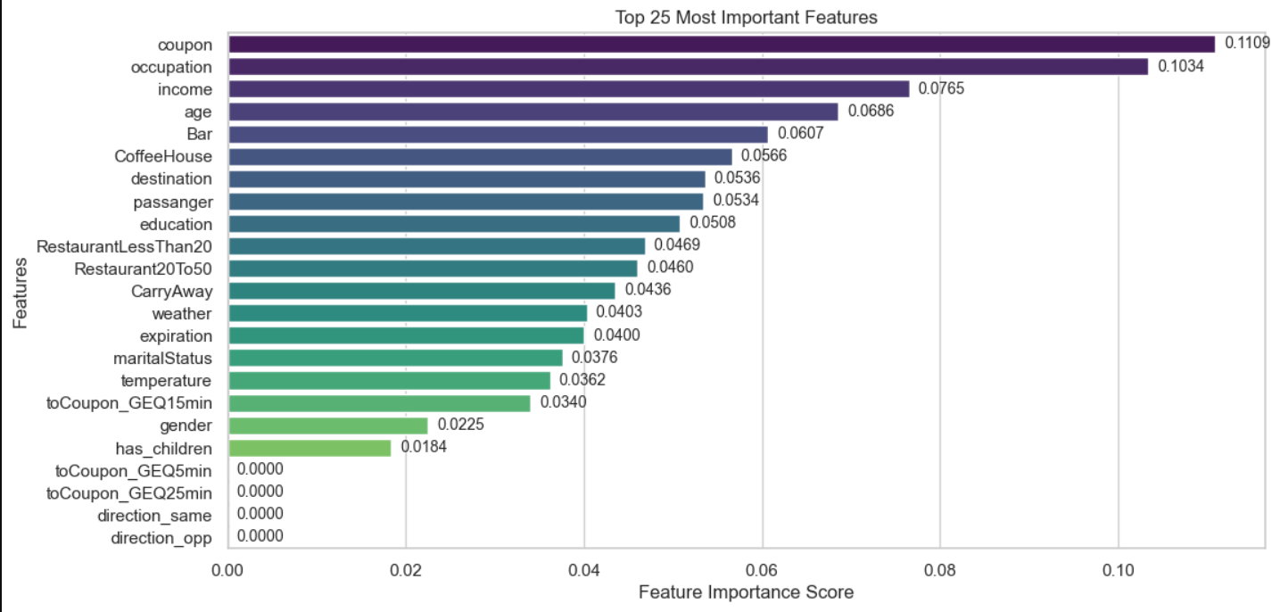



Feature Importance
Coupon
Most important feature with 11.09% importance.
Occupation
Second most important at 10.34%.
Income
Third most important 7.65%.

Slide 11
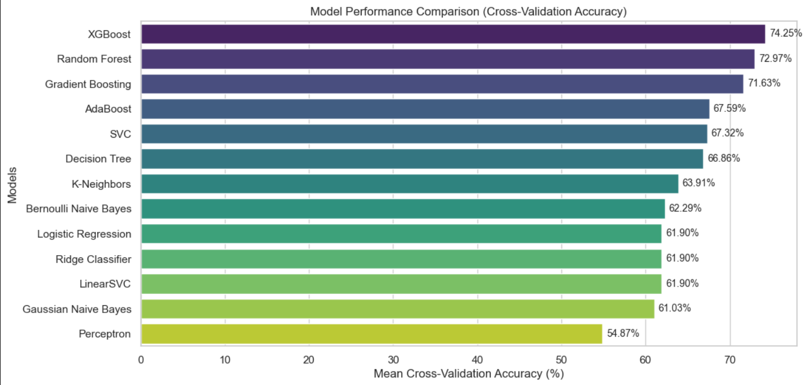
Model Performance Comparison
Best Performer
Runner-up
Baseline
XG Boost achieved highest model accuracy of 74.25%.
Random Forest achieved second highest model accuracy of 72.97%
Perceptron gave a model accuracy of 54.87%

Slide 12

Key Findings
1
Best Model
XG Boost outperformed other models in predicting coupon acceptance.
2
Important Factors
Occupation and coupon significantly influence the coupon acceptance on E-commerce
3
Model Accuracy
Achieved 74.25% accuracy in predicting coupon acceptance.

Slide 13

THANK YOU

